Slide 1

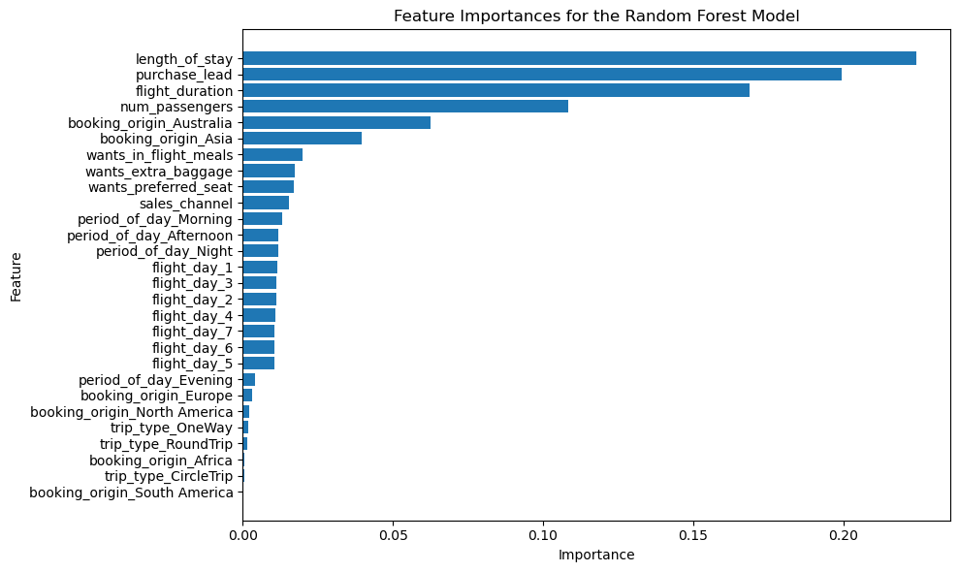
Predicting Customer Buying Behaviour
Result of Findings
Only 15% of customers completed their bookings.
Length of stay, purchase lead, flight duration, and number of passengers contributed most to the model.
Random Forest model produced the highest accuracy of around 79%, but with a very poor precision (0.26), recall (0.19) and F1 score (0.22) on the successful booking class which suggests that the model perform poorly in predicting the class.
We need more features about the customers and price of flights etc, as well as more dataset to better improve the model..

